Slide 1
Better Together: Text + Context
Kenneth Church

Slide 2
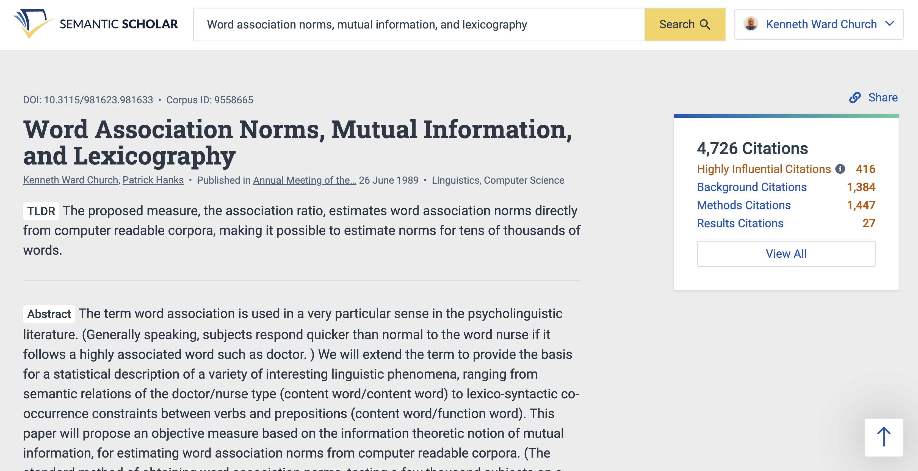

Slide 3
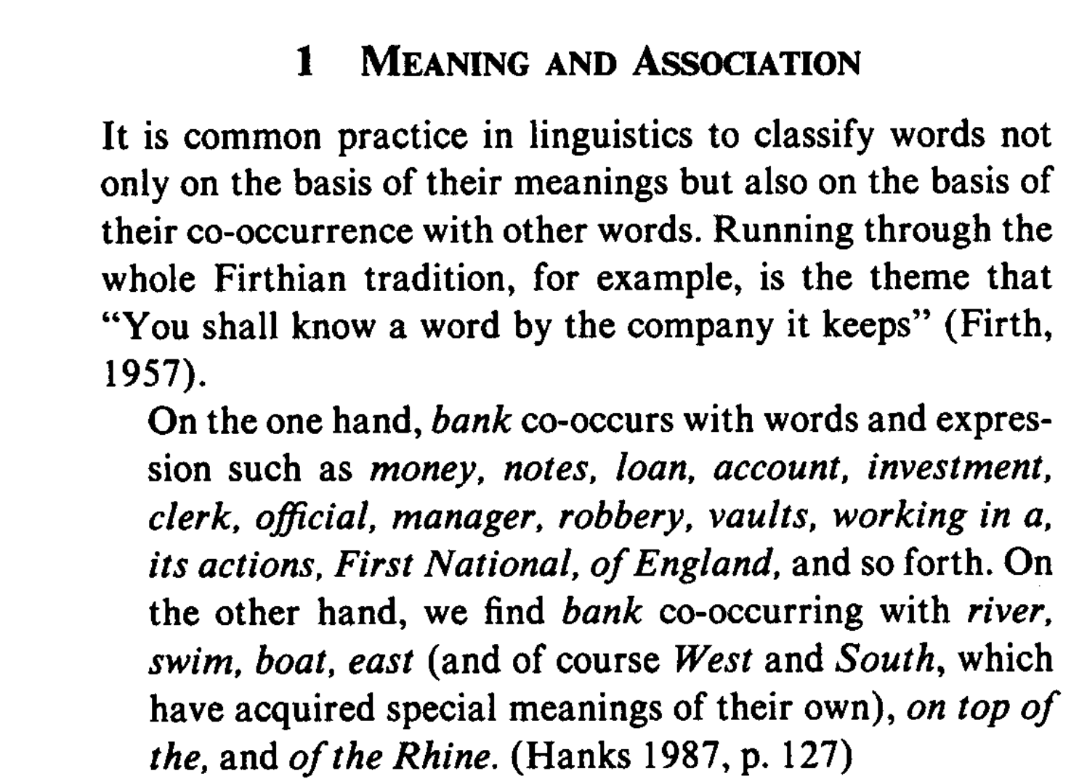
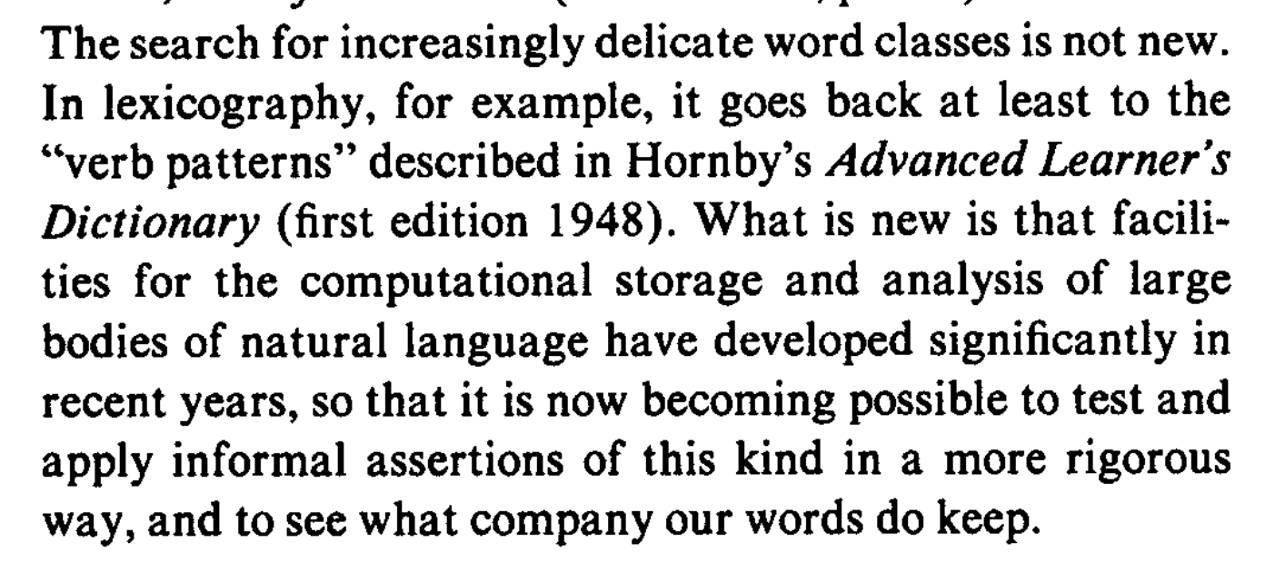
``You shall know a word by the company it keeps’’

Slide 4
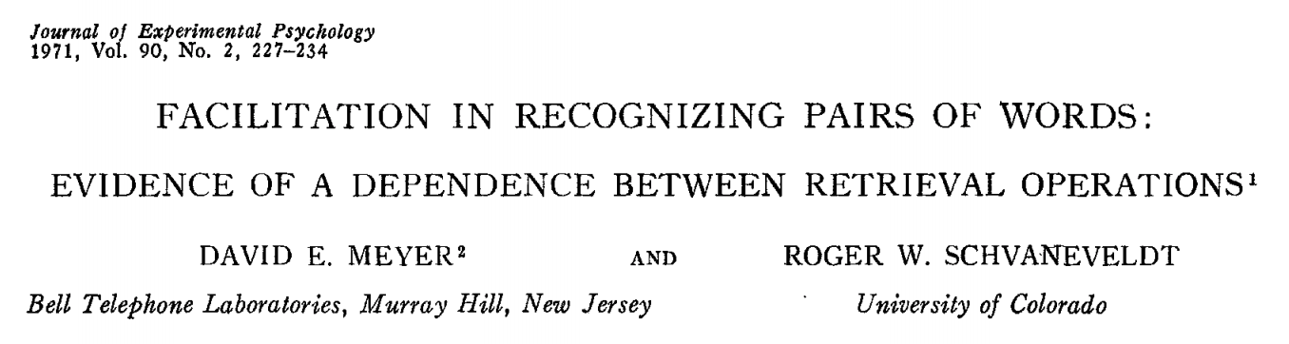
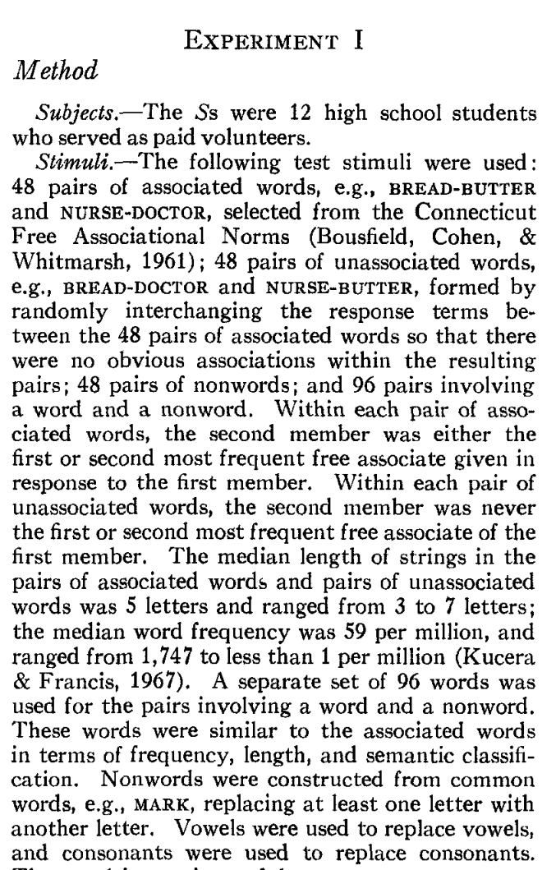
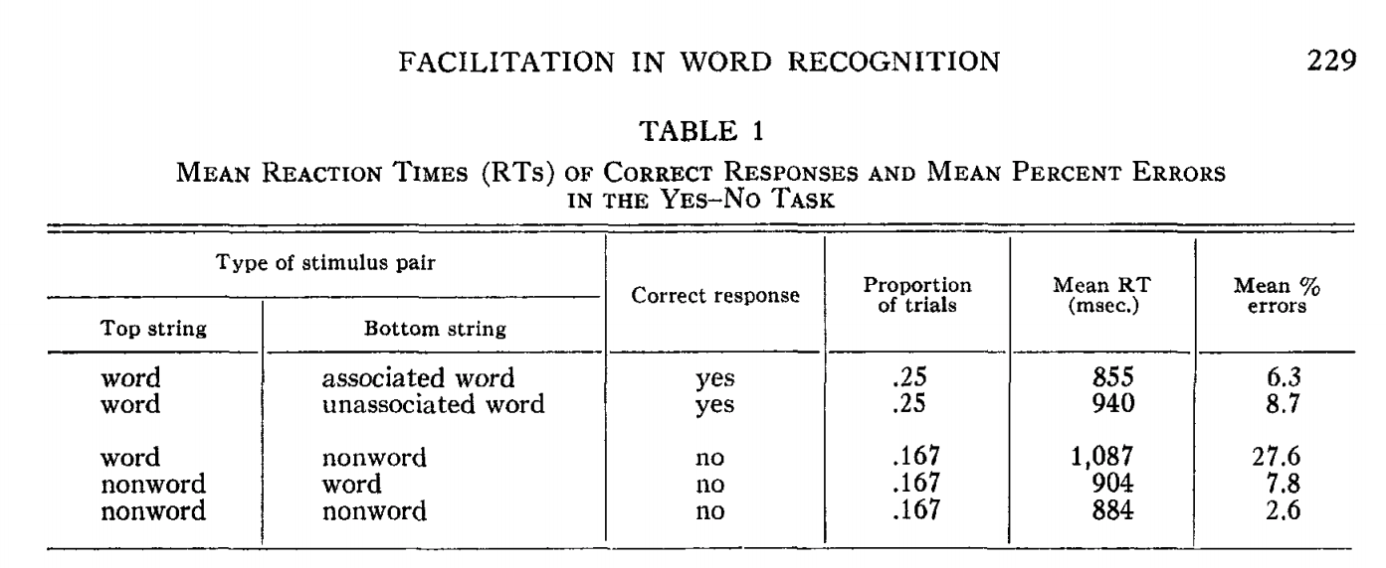
Priming & Word Associations Task: Subject is given two strings and responds “yes” if both are words

Slide 5
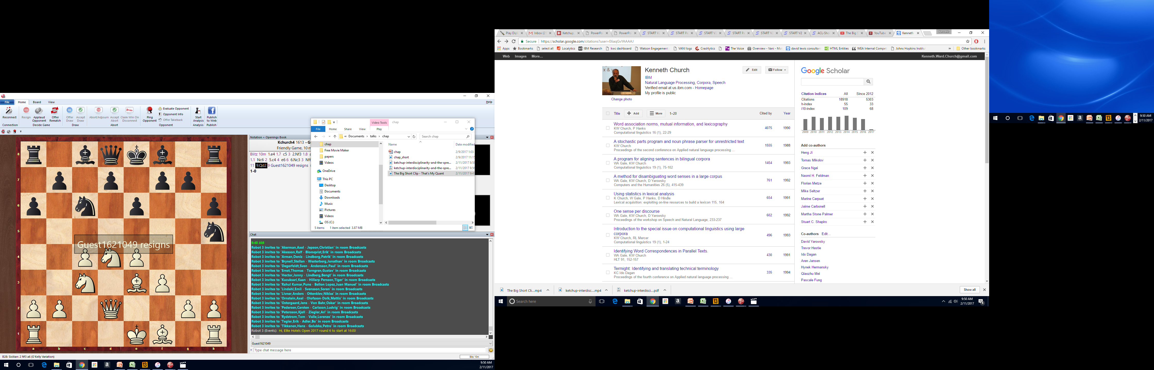
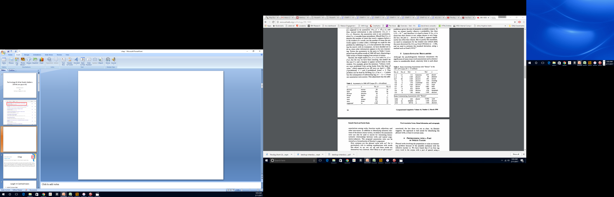
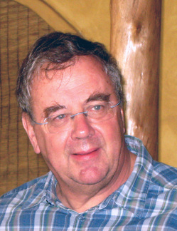

Slide 6
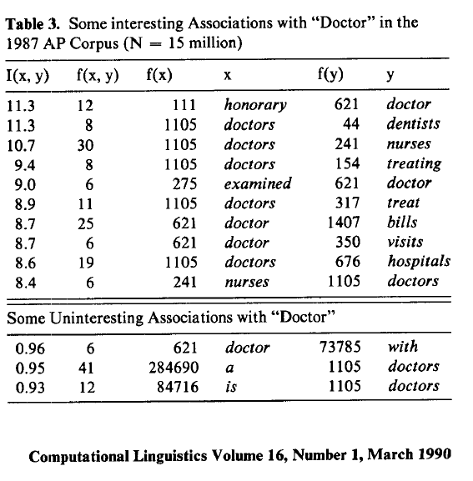
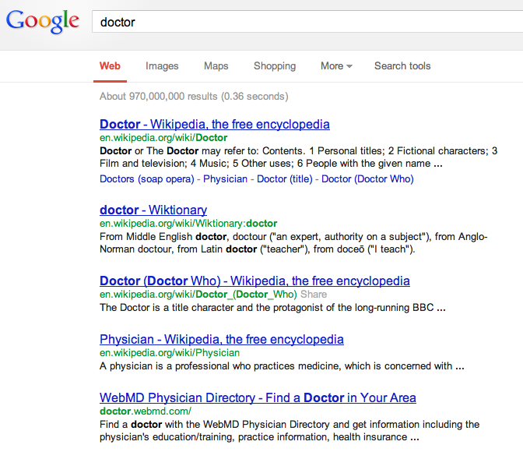
There is no data like more data
Counts are growing 1000x per decade
(same as disks)
Counts are growing 1000x per decade
(same as disks)
Rising Tide of Data Lifts All Boats

Slide 7
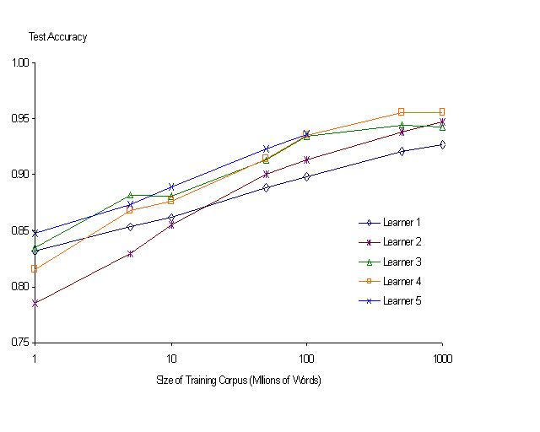
“It never pays to think until you’ve run out of data” – Eric Brill
Moore’s Law Constant:
Data Collection Rates → Improvement Rates
Banko & Brill: Mitigating the Paucity-of-Data Problem (HLT 2001)
No consistently
best learner
There is no data like more data
Quoted out of context
Fire everybody and
spend the money on data

Slide 8
PMI → Word2vec → BERT → Chatbots
Historical Precedents
Word Associations: doctor primes nurse
Perplexity (Shannon), Cloze task, Fill mask
``You shall know a word by the company it keeps’’
Collocations in Lexicography

Slide 9
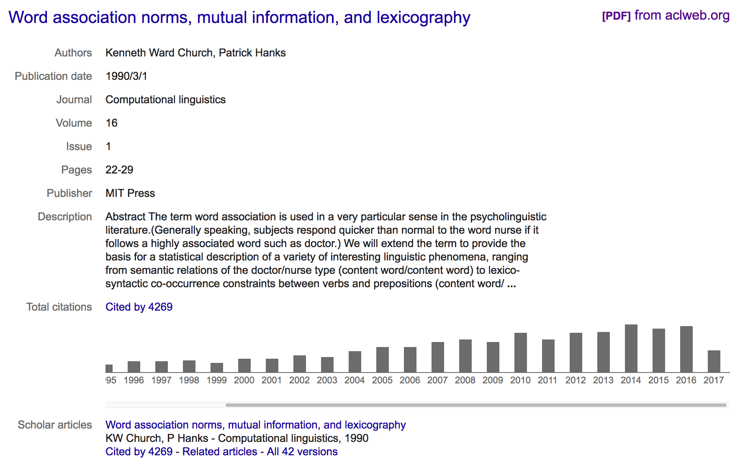
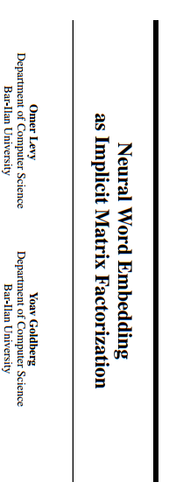
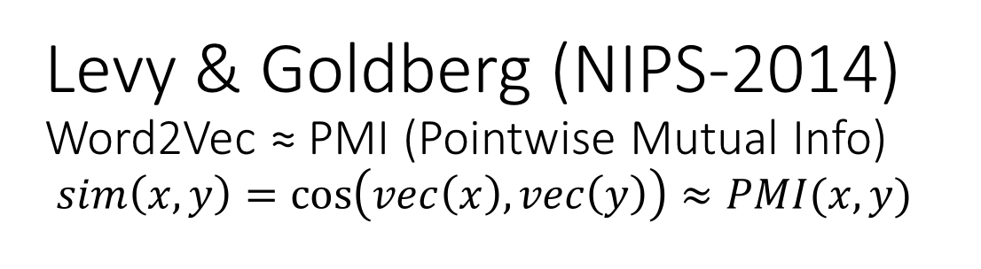
Levy & Goldberg (NIPS-2014) Word2Vec ≈ PMI (Pointwise Mutual Info) $sim\left(x,y\right)=\cos\left(vec\left(x\right), vec\left(y\right)\right)≈PMI(x,y)$
What happened in 2014?

Slide 10
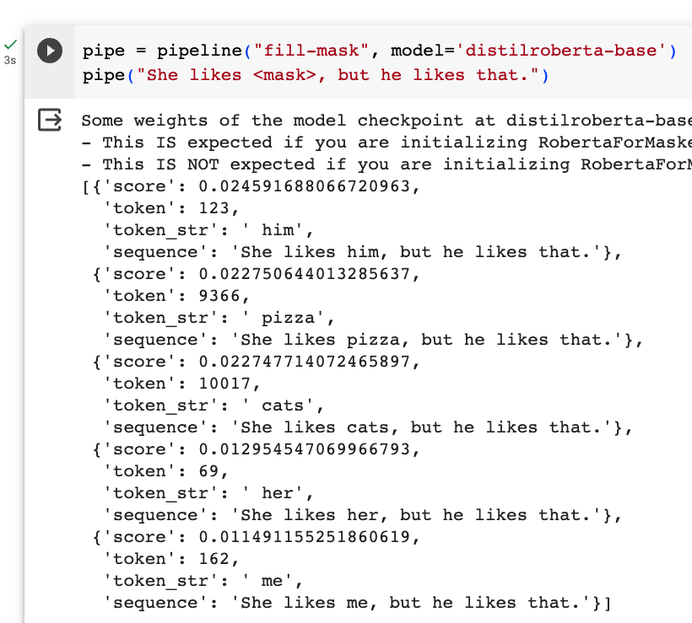
Fill Mask (Cloze Task)

Slide 11
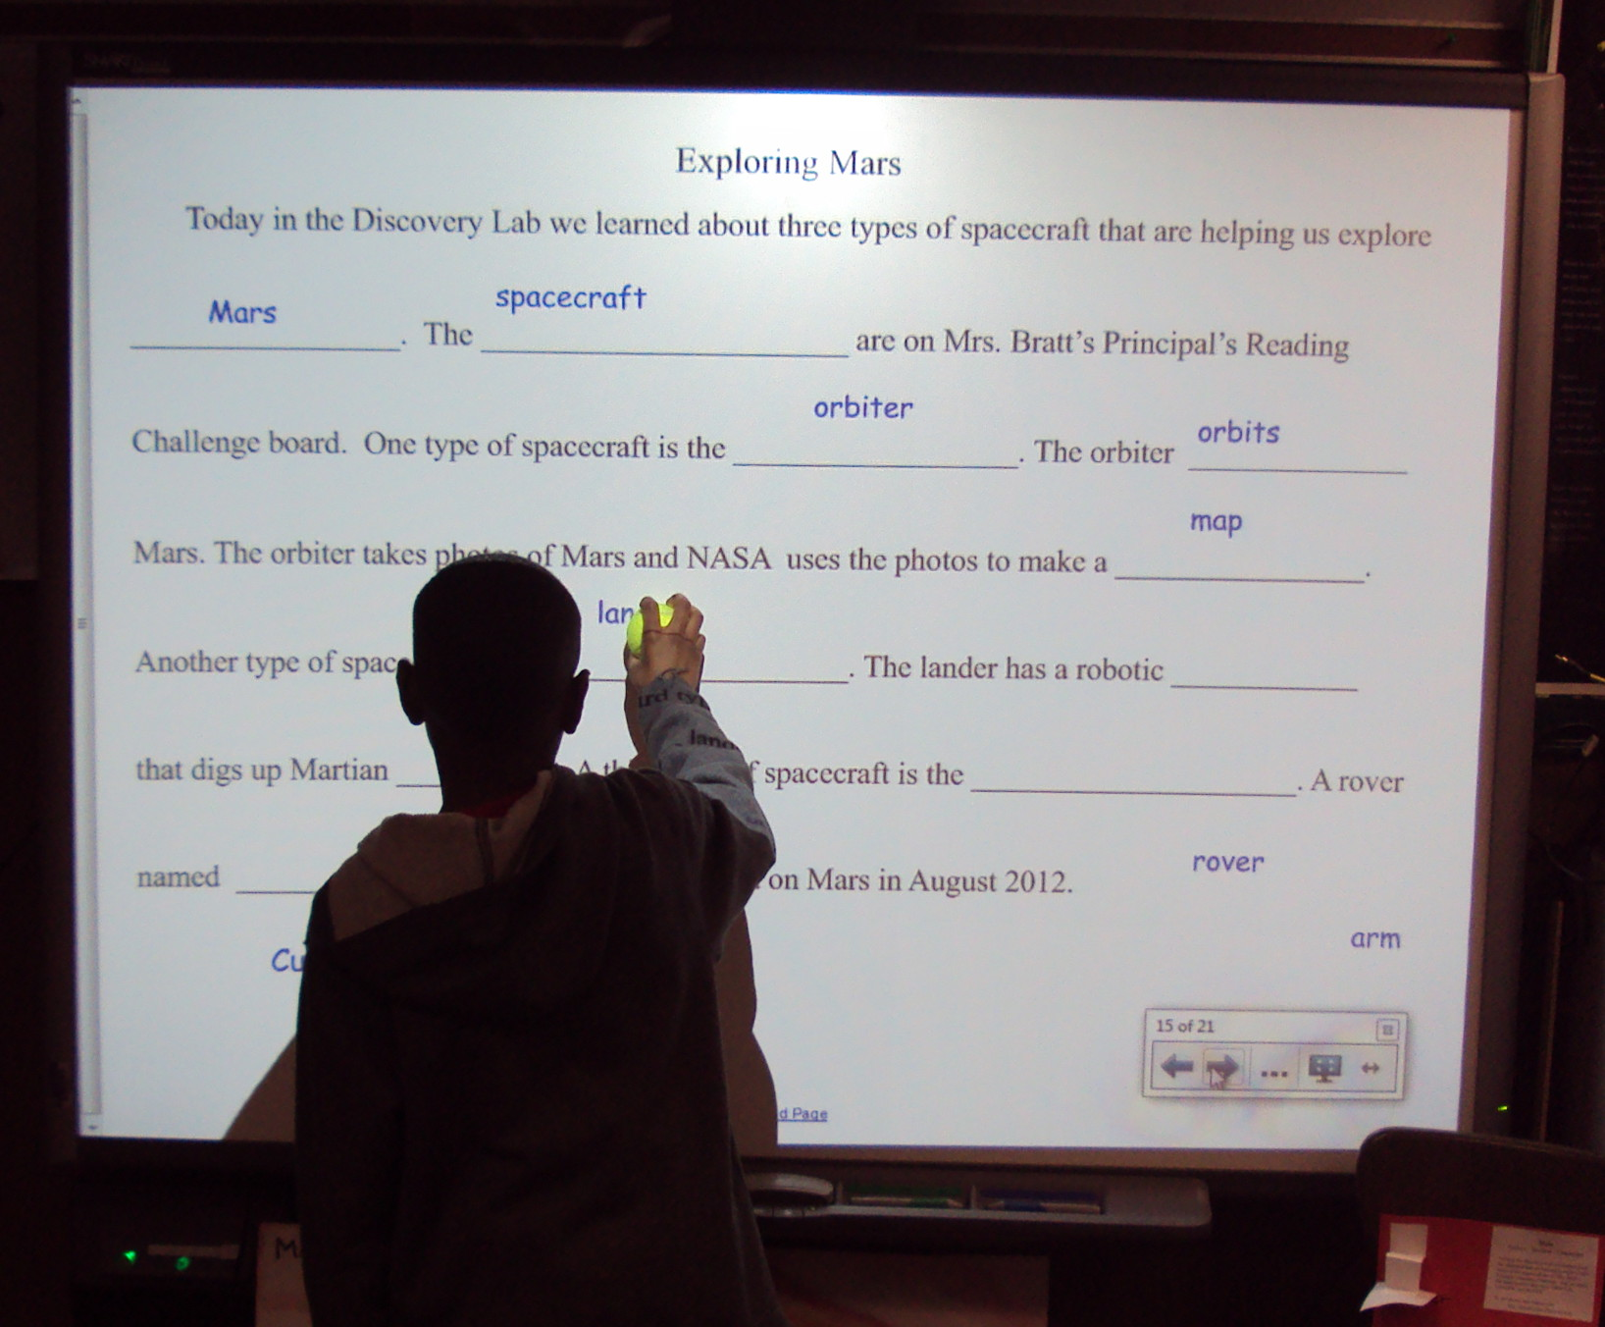
More Inference Tasks: Classification, Fill Mask, … echo … | gft_predict –task fill-mask
BERT: Fill-Mask (Delvin et al, 2019)
Cloze Task (1953)
Input | Choice 1 |  | Choice 2
I <mask> you | miss | 30% | love | 17%
I <mask> him | love | 14% | miss | 13%
I <mask> her | love | 16% | miss | 12%
I love <mask> | him | 2% | cats | 2%
I <mask> New York | love | 33% | miss | 17%
I love the <mask> guy | pizza | 2% | funny | 2%
I hate the <mask> guy | fucking | 3% | pizza | 2%
By Laurie Sullivan - DSC01784, CC BY 2.0, https://commons.wikimedia.org/w/index.php?curid=62727253

Slide 12
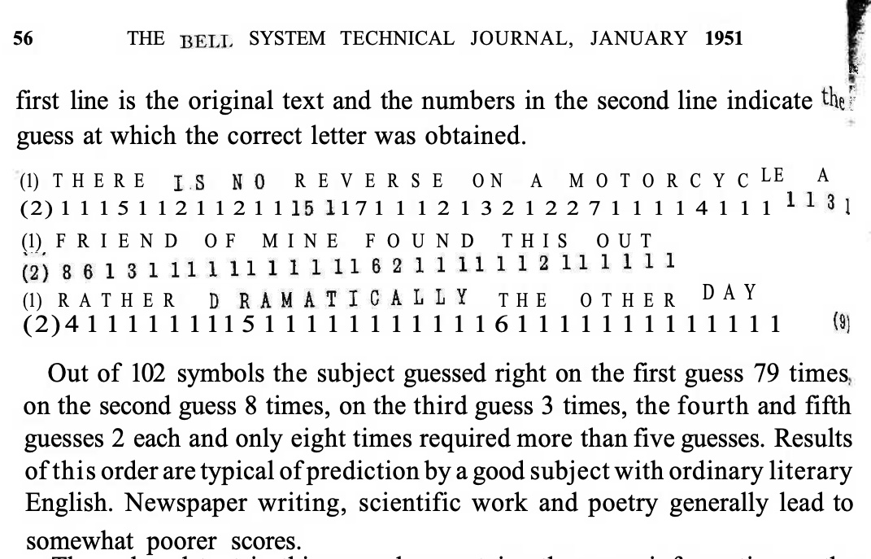
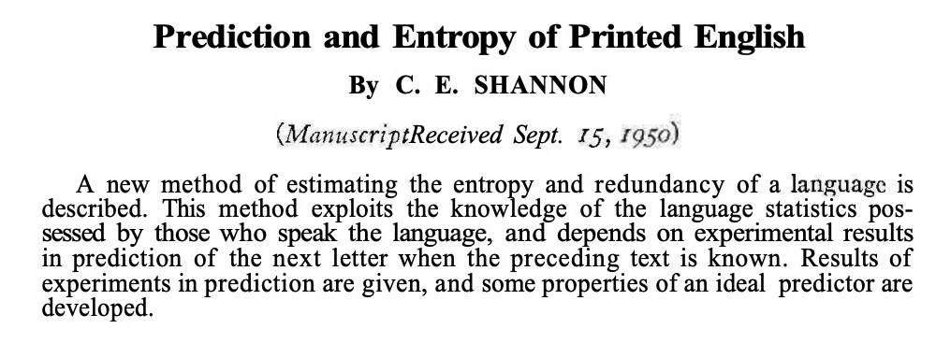
Lots of History: Fill-mask, Cloze Task, Entropy

Slide 13

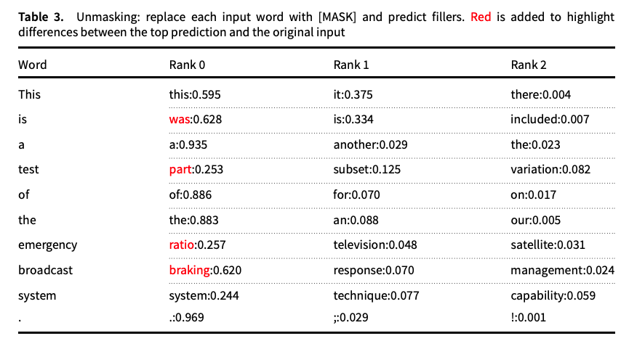
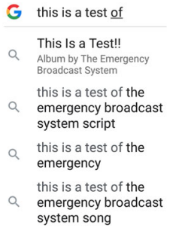
Guess the missing word in a cliché (from “Emerging trends: Deep nets for poets”)
Fill Mask
Autocomplete in Search

Slide 14
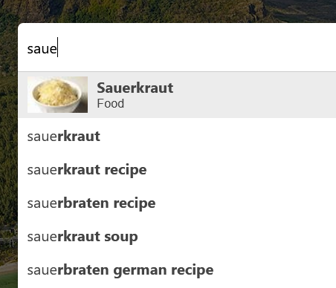
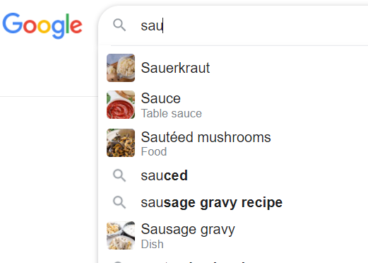

Autocomplete $≠$ Fill-Mask

Slide 15
How to succeed? (get beyond publishing)
How to get citations
Paradigm Shift (Kuhn)
First? Last? Best?
Probably not
Better:
Accessible
Helpful to audience
Data
Tools
Survey
Accessible
Initial promising results
promising >> convincing
Leave enough undone for students to contribute
and benefit by doing so

Slide 16
Word2vec is popular (massively cited)
Word2vec is not first, last or best to discuss
Vector spaces, embeddings, analogies, similarity metrics, etc.
But word2vec is simple and accessible
Anyone can download the code and use it in their next paper.
Any many do (for better and for worse)
Available downloads
Pre-computed vectors (no training required)
Code for training your own vectors on your own corpora

Slide 17
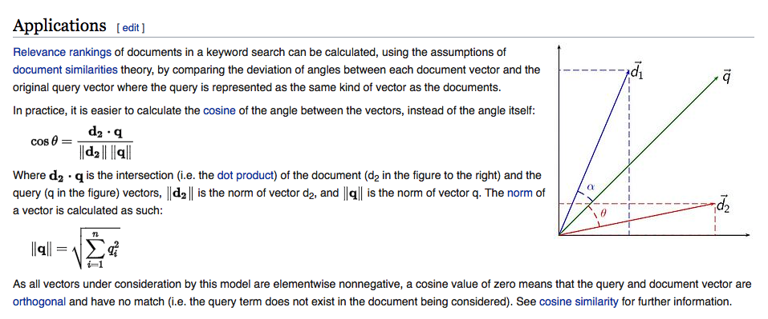
Embeddings: Similarity of docs/words ≈ cos (dot product)

Slide 18
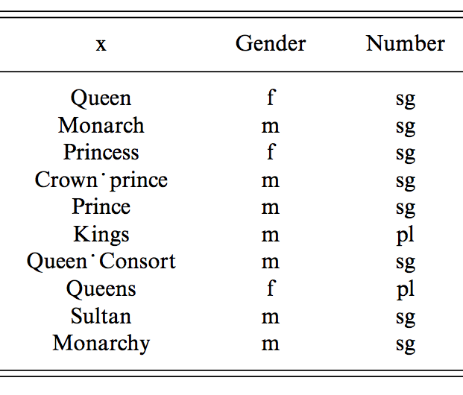
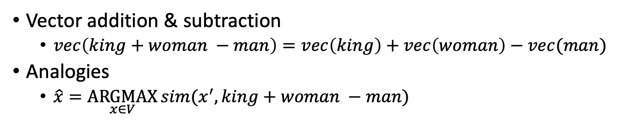
man : woman :: king : x
Vector addition & subtraction
$vec\left(king+woman −man\right)=vec\left(king\right)+vec\left(woman\right)−vec(man)$
Analogies
$\hat{x}=\underset{x∈V}{ARGMAX}{sim(x^{′}, king+woman −man)}$

Slide 19
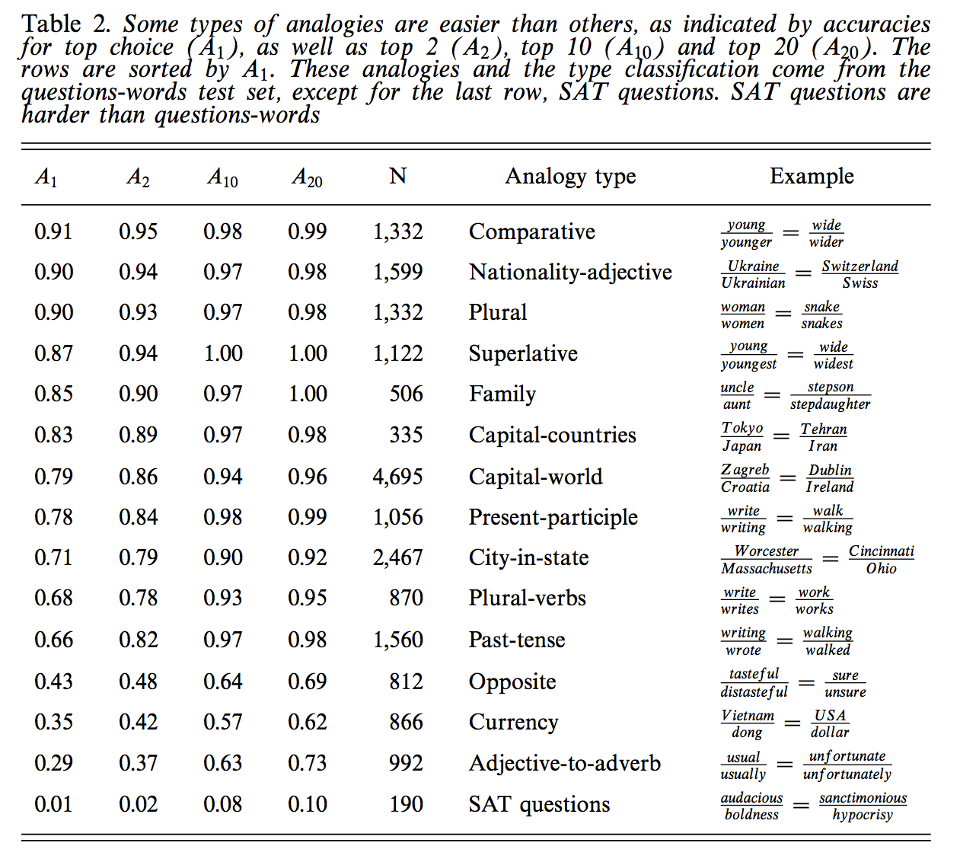
Some analogies are easier than others
Tweets
RT @tallinzen: sure, king:queen etc, but did you know word2vec gets real SAT analogies right just 1% of the time?
15 copies of this tweet
Some by NLP experts
Resources Debate
WordNet &
British National Corpora

Slide 20
Need to Re-organize Courses (Interdisciplinary Re-Org)
Current Courses (and Conferences)
Future
Machine Learning (ML)
Vision
Natural Language (NLP)
Machine Translation (MT)
Information Retrieval (IR)
Speech
Machine Learning (ML)
ML Applications
Vision/NLP/MT/IR/Speech

Slide 21
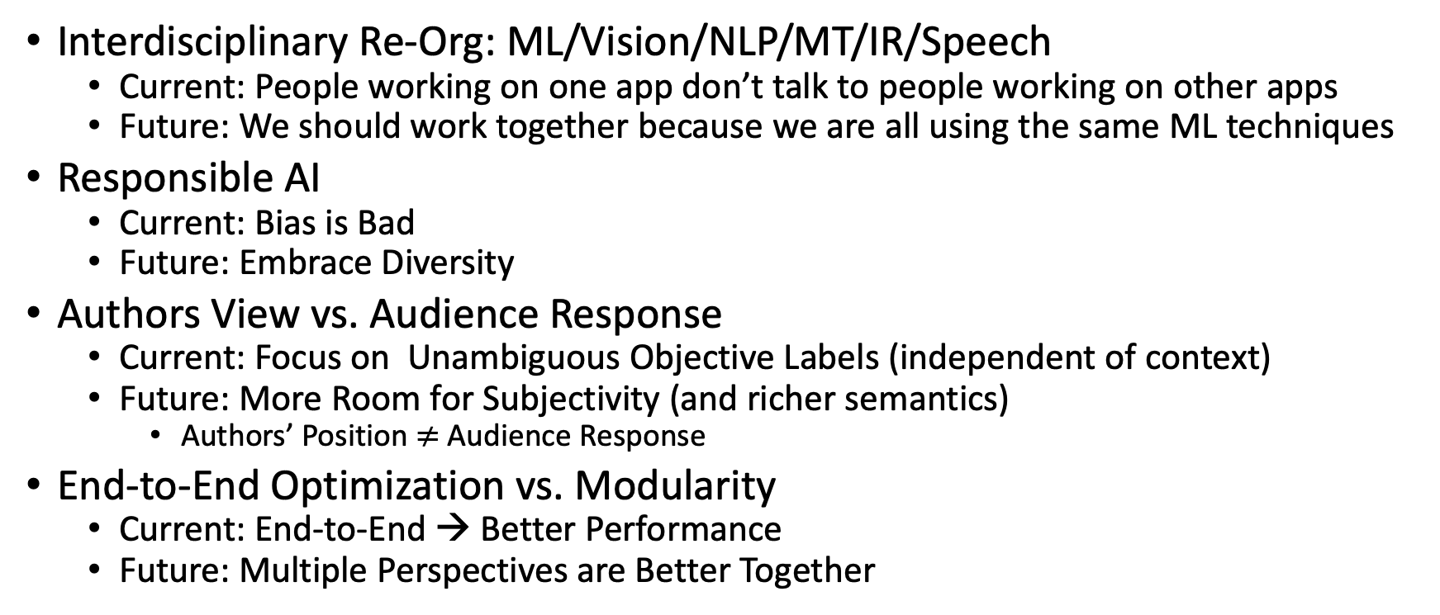
Soap Box: My Views
Interdisciplinary Re-Org: ML/Vision/NLP/MT/IR/Speech
Current: People working on one app don’t talk to people working on other apps
Future: We should work together because we are all using the same ML techniques
Responsible AI
Current: Bias is Bad
Future: Embrace Diversity
Authors View vs. Audience Response
Current: Focus on Unambiguous Objective Labels (independent of context)
Future: More Room for Subjectivity (and richer semantics)
Authors’ Position $≠$ Audience Response
End-to-End Optimization vs. Modularity
Current: End-to-End → Better Performance
Future: Multiple Perspectives are Better Together

Slide 22
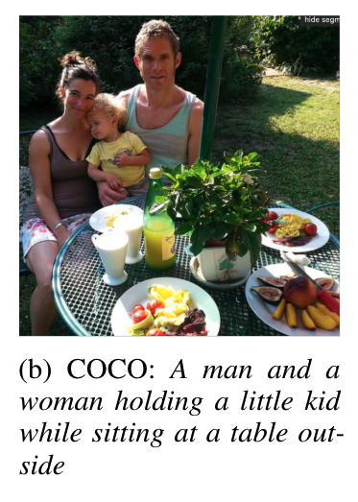
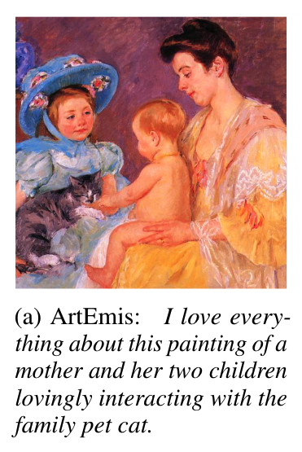
Vision: Facts → Opinions
Facts
Opinions

Slide 23
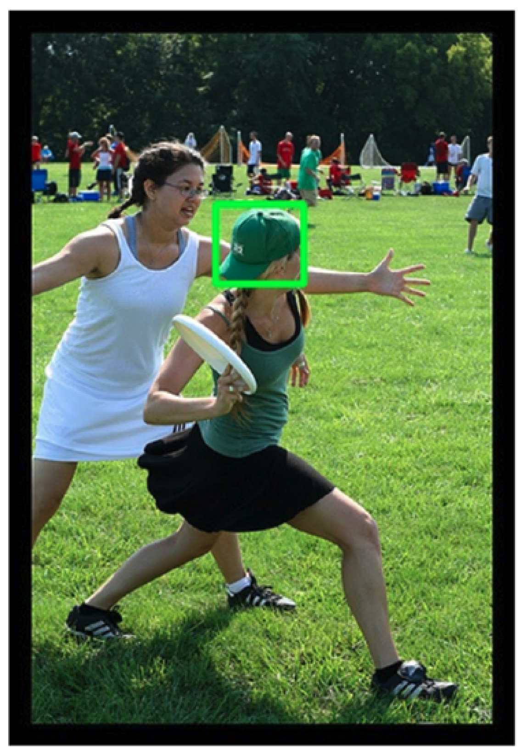
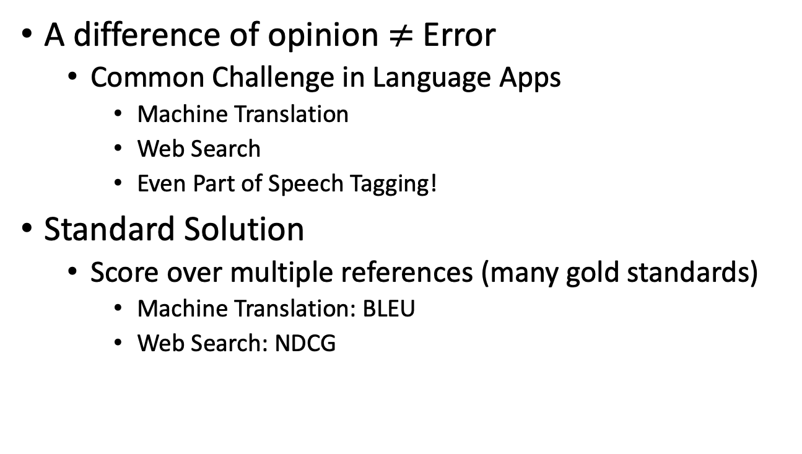
Ambiguity: No Single Correct Gold Label
A difference of opinion $≠$ Error
Common Challenge in Language Apps
Machine Translation
Web Search
Even Part of Speech Tagging!
Standard Solution
Score over multiple references (many gold standards)
Machine Translation: BLEU
Web Search: NDCG
Candidate labels: baseball cap, cap, green hat, hat, head.
Can you guess which one is in the gold standard?

Slide 24
Classic Challenges in Philosophy of Language Compare & Contrast Language in Visual Genome (VG) with NLP Corpora
Bounding Box Semantics: Too Limiting
<NP> <relation> <NP>
NPs in VG are usually rigid designators that mean the same thing in all contexts
Few abstract nouns (ideas), predicates (verbs, adj), variables (pronouns)
Most VG nouns are visual (and less about other senses)
More entropy in nouns than relations
8 boring relations cover bulk of the cases
Linguists are more interested in predicates than arguments
Modifiers are limited to a single box
Relative Relations: girl with green hat vs girl on defense
Aggregations over boxes
Count vs. Mass: Cloudy Sky, Sandy Beach
Definite vs. Indefinite: girls playing frisbee (as opposed to many other people in picture)
A horse with two legs?

Slide 25
Verbs, Subjunctive, Focus, Perspective, etc…
Pictures vs. Videos
Captions on pictures have more nouns:
girl with green hat
Captions on videos have more verbs:
girl throwing frisbee
Possible Worlds: Subjunctive, Hedges
The girl on defense might block the throw,
but probably won’t
Focus: girl on offense vs. girl on defense
Perspective: photographer vs. audience

Slide 26
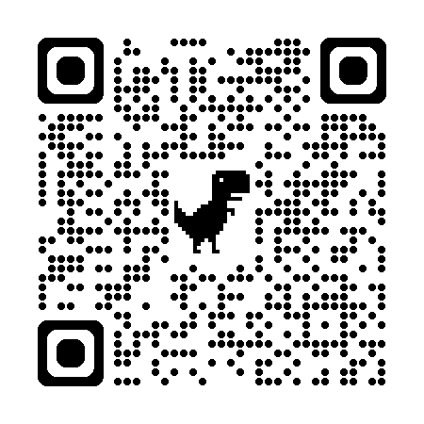
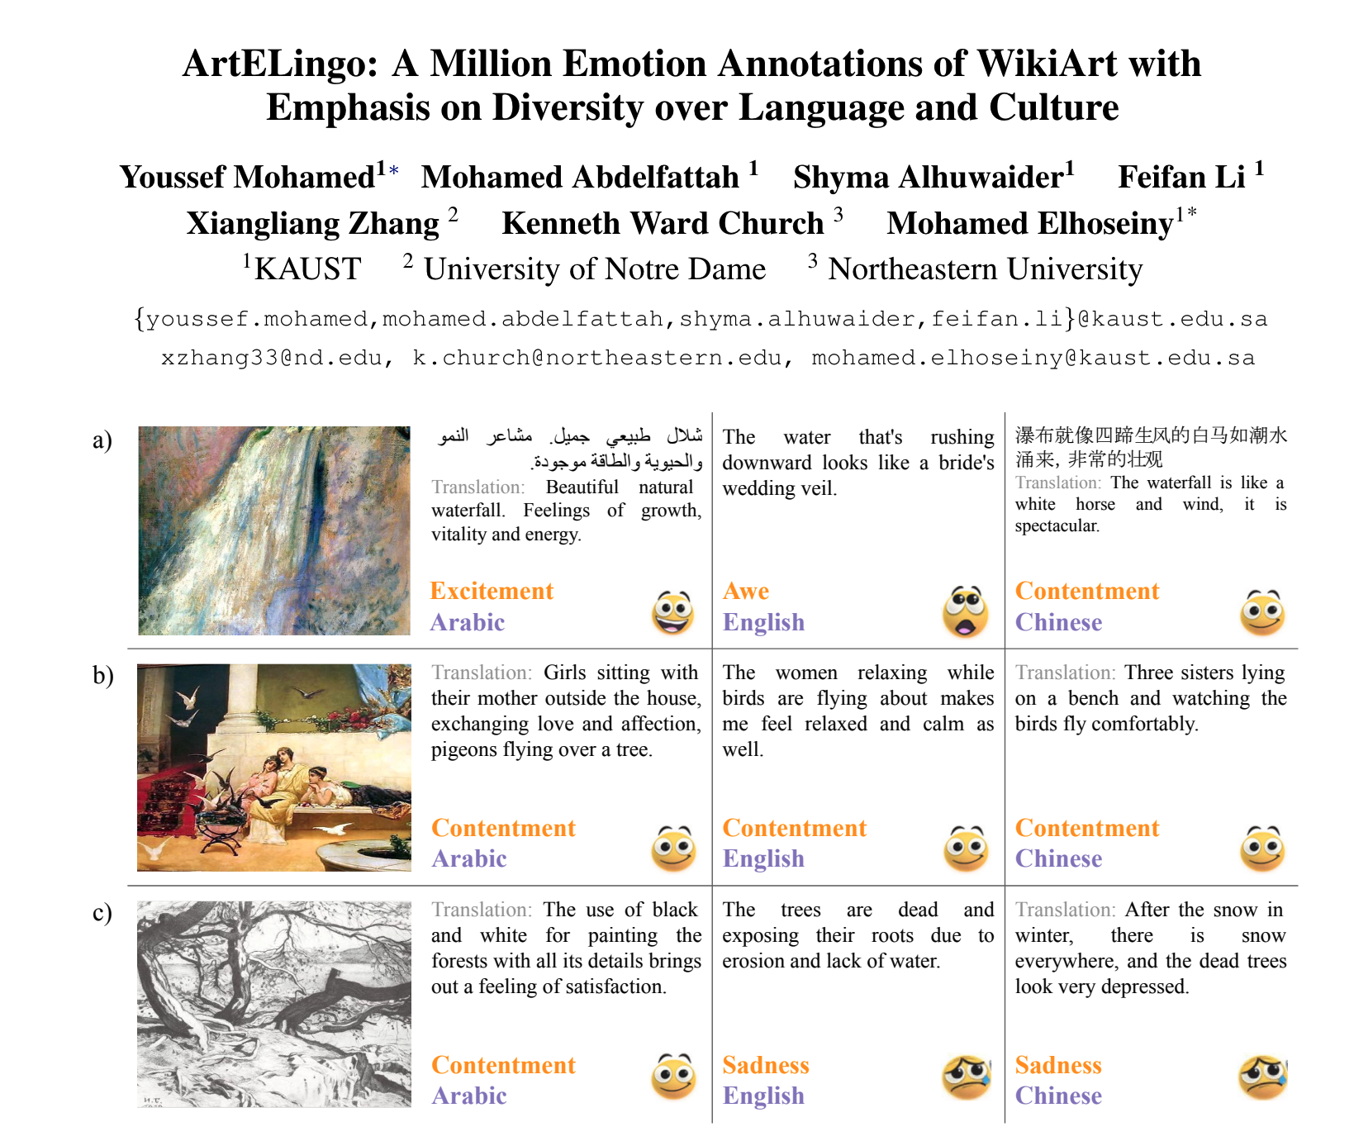

Slide 27
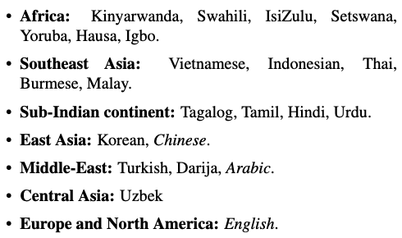
ArteLingo-23: Embrace Diversity over Language and Culture

Slide 28
Why study more languages?
Vision:
Depends on both stimulus as well as context
Stimulus: Picture
Context: Language, Culture, Religion, Politics, Education, Background
Cliché:
Beauty is in the eye of the beholder

Slide 29
Few Shot & Zero Shot

Slide 30
Anglo-Centered Baseline
Use English as Pivot Language
Anglo-Centered Vision Task:
Input: Picture
Output: English Caption
If you want a caption in another language:
Just translate English caption to that language
Challenge:
Can we do better than that?

Slide 31
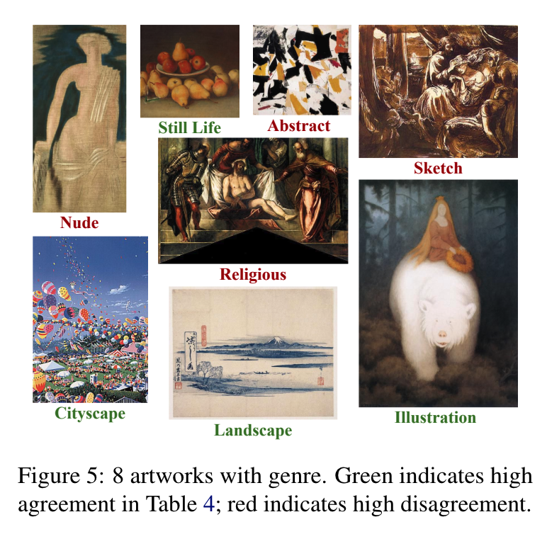
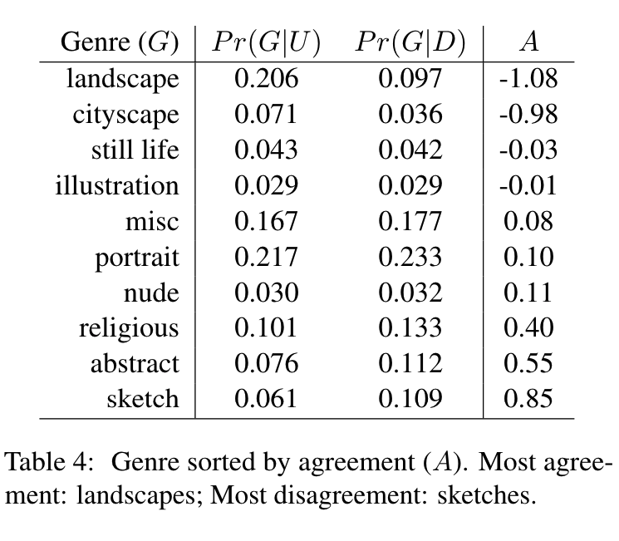
Agreement (A) on Emotion Labels: More A: Landscapes → Less A: Sketches

Slide 32
Agreement on Emotion Labels
By Genre
By Language (or perhaps Education?)

Slide 33
Academic Search

Slide 34
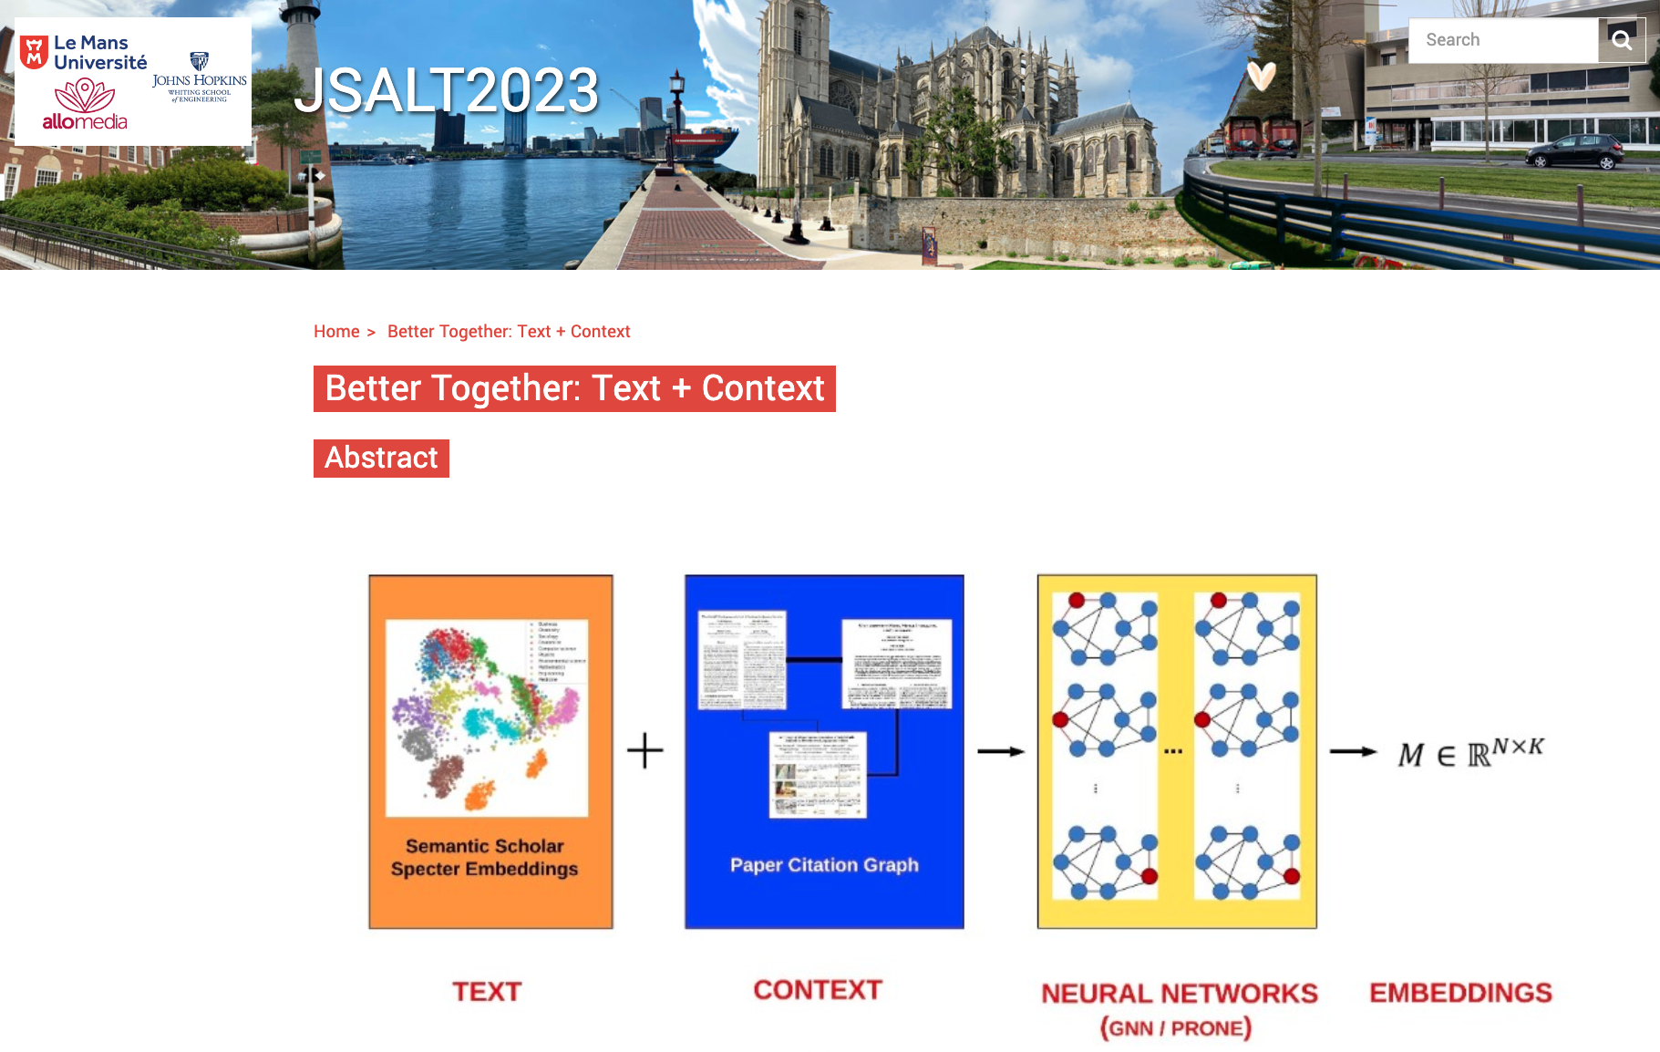
2023 Jelinek Summer Workshop on Speech and Language Technology https://www.clsp.jhu.edu/2023-jelinek-summer-workshop/

Slide 35
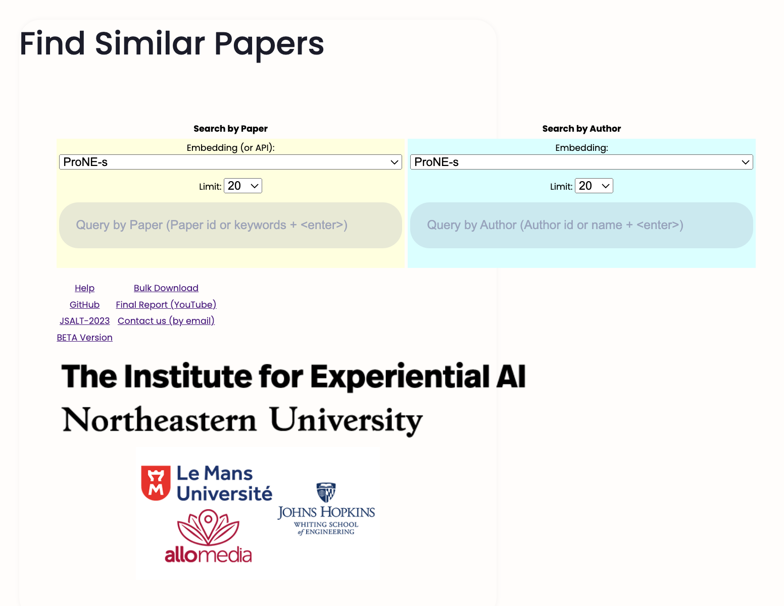
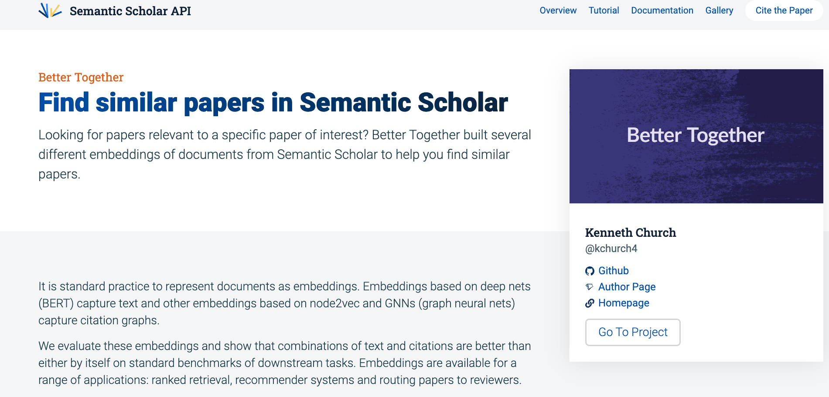
Google Search: Semantic Scholar Gallery

Slide 36

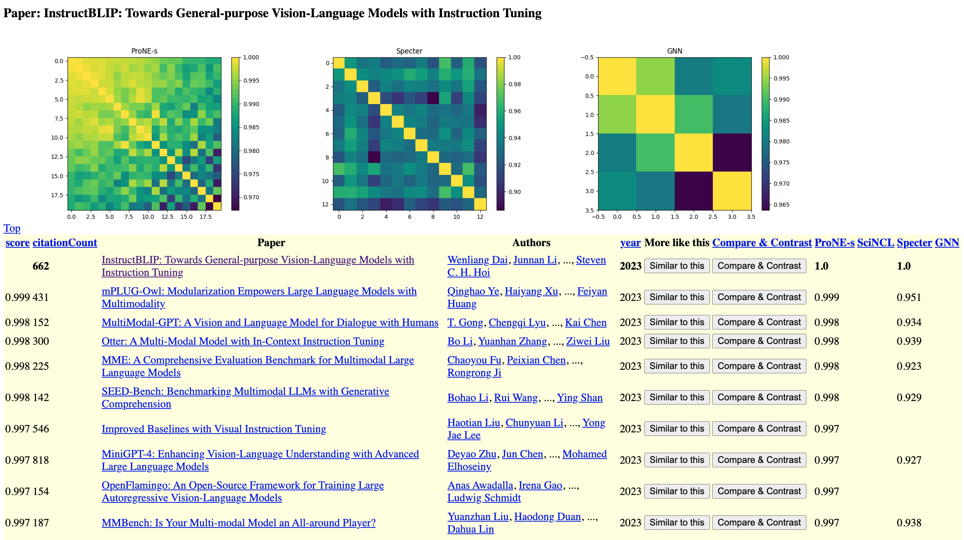
Google Search: Gallery Semantic Scholar

Slide 37

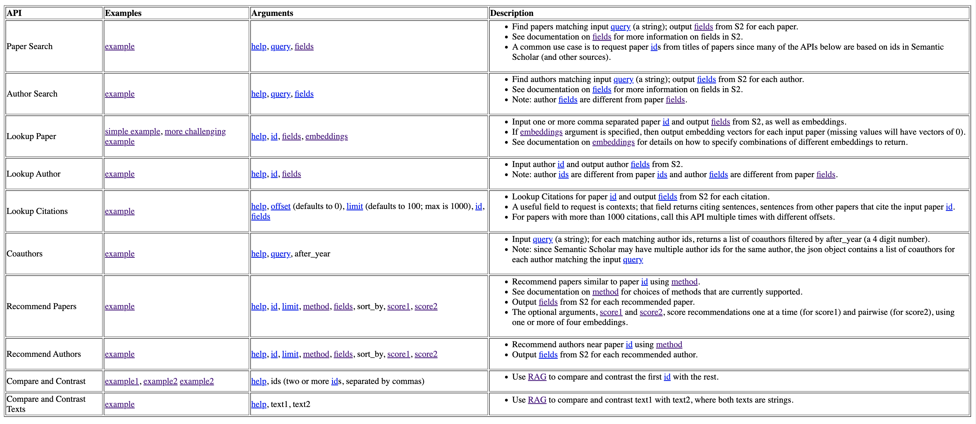
APIs

Slide 38
APIs
Paper Search:
find paper ids matching input query
Author Search:
find author ids matching input query
Lookup Paper:
lookup fields and embeddings by id
Lookup Author:
lookup fields by id
Recommend Papers:
input paper id and output more paper ids
Recommend Authors:
input paper id and output author ids
Compare and Contrast:
use RAG to compare and contrast one paper id with more paper id(s)
paper ids:
Includes ids from
Semantic Scholar (S2)
PubMed
ACL
arXiv
MAG (Microsoft Academic Graph)
embeddings: Specter, ProNE, etc
fields (from S2): properties of ids
title, authors, tldr, abstract, bibtex, references, citations

Slide 39
Surveys on Academic Search
Content-Based Filtering (CBF): Abstracts (Specter)
Graph-Based Methods (GB): Citations (ProNE)
Collaborative Filtering (CF): Clicks
Better Together: Hybrids/Ensembles of above
Why study academic search?
Academic search is like many important recommendation tasks
eCommerce (Product Recommendation), Traffic Analysis (Defense)
But data is less sensitive and available
We will have little to say about CF
Because behavioral signals (clicks) are sensitive

Slide 40
Materials
Large and Growing
Semantic Scholar (S2)
200+ Million Papers (nodes)
and 2+ Billion Citations (edges)
Literature doubles every 9 years!

Slide 41
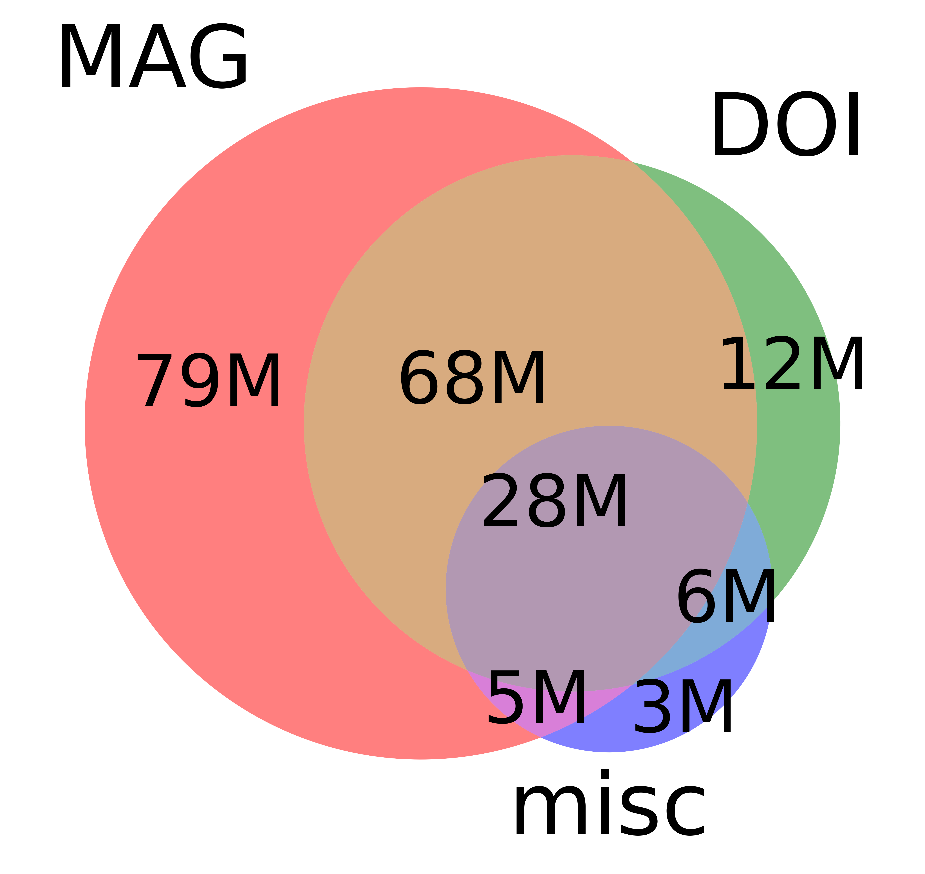
More on Materials
Seven Sources:
Two Big Sources: MAG, DOI
Five More (misc): PubMed, PubMedCentral, DBLP, arXiv, ACL
arXiv and ACL are tiny
Many fields of study:
Medicine (45M), Chemistry (13M), CS (13M), Biology (13M), Materials Science (10M), Engineering (8M), Physics (7M), Psychology (7M), Mathematics (5M), Political Science (4M), Business (4M), Sociology (3M), Geography (3M), Economics (3M), Environmental Science (3M), Geology (3M), History (2M), Art (2M), Philosophy (1M)
Not just CS (Computer Science)

Slide 42
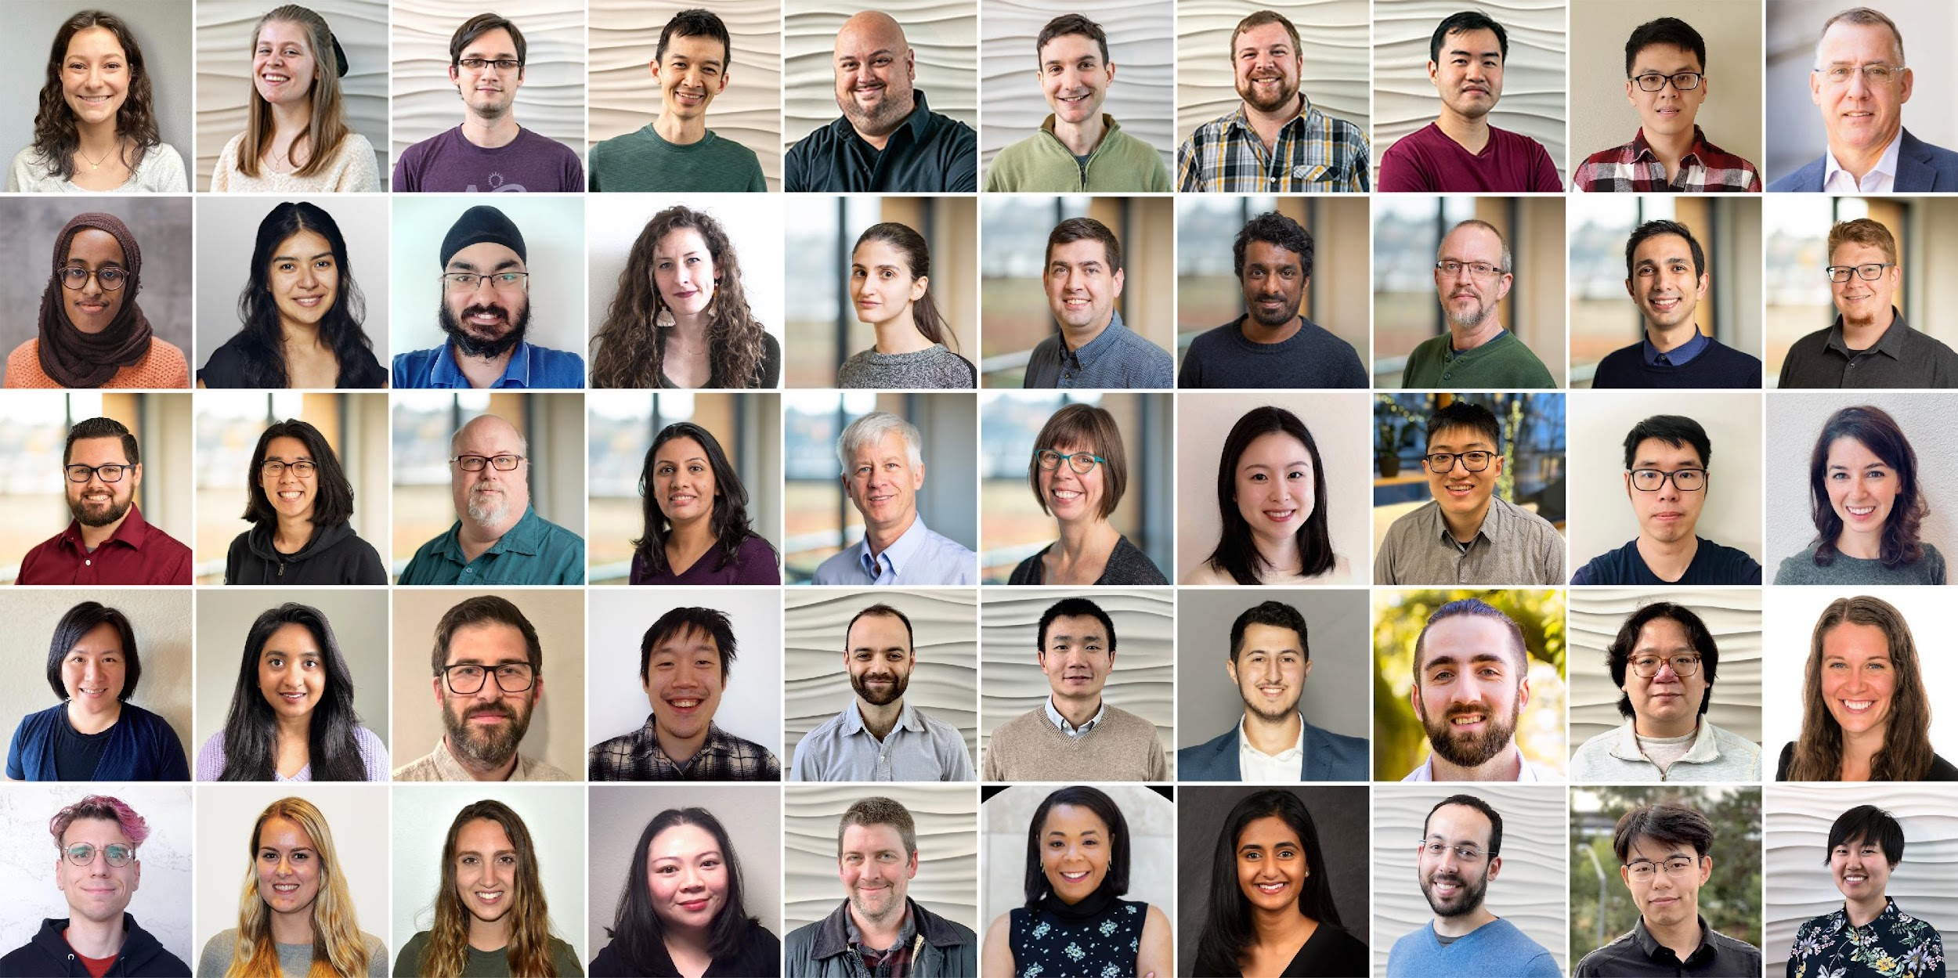
Semantic Scholar: Significant Effort (source: Dan Weld)
SCALE | SCALE
 | Source | Papers (millions)
1 | CorpusId | 207.80
2 | MAG (Microsoft Academic Graph) | 182.18
3 | DOI | 113.54
4 | PubMed | 35.03
5 | DBLP | 6.06
6 | PubMedCentral | 4.86
7 | ArXiv | 2.15
8 | ACL | 0.08
50 person team; 7 year project
207M+ papers; 2B Citations
8M+ monthly active users

Slide 43
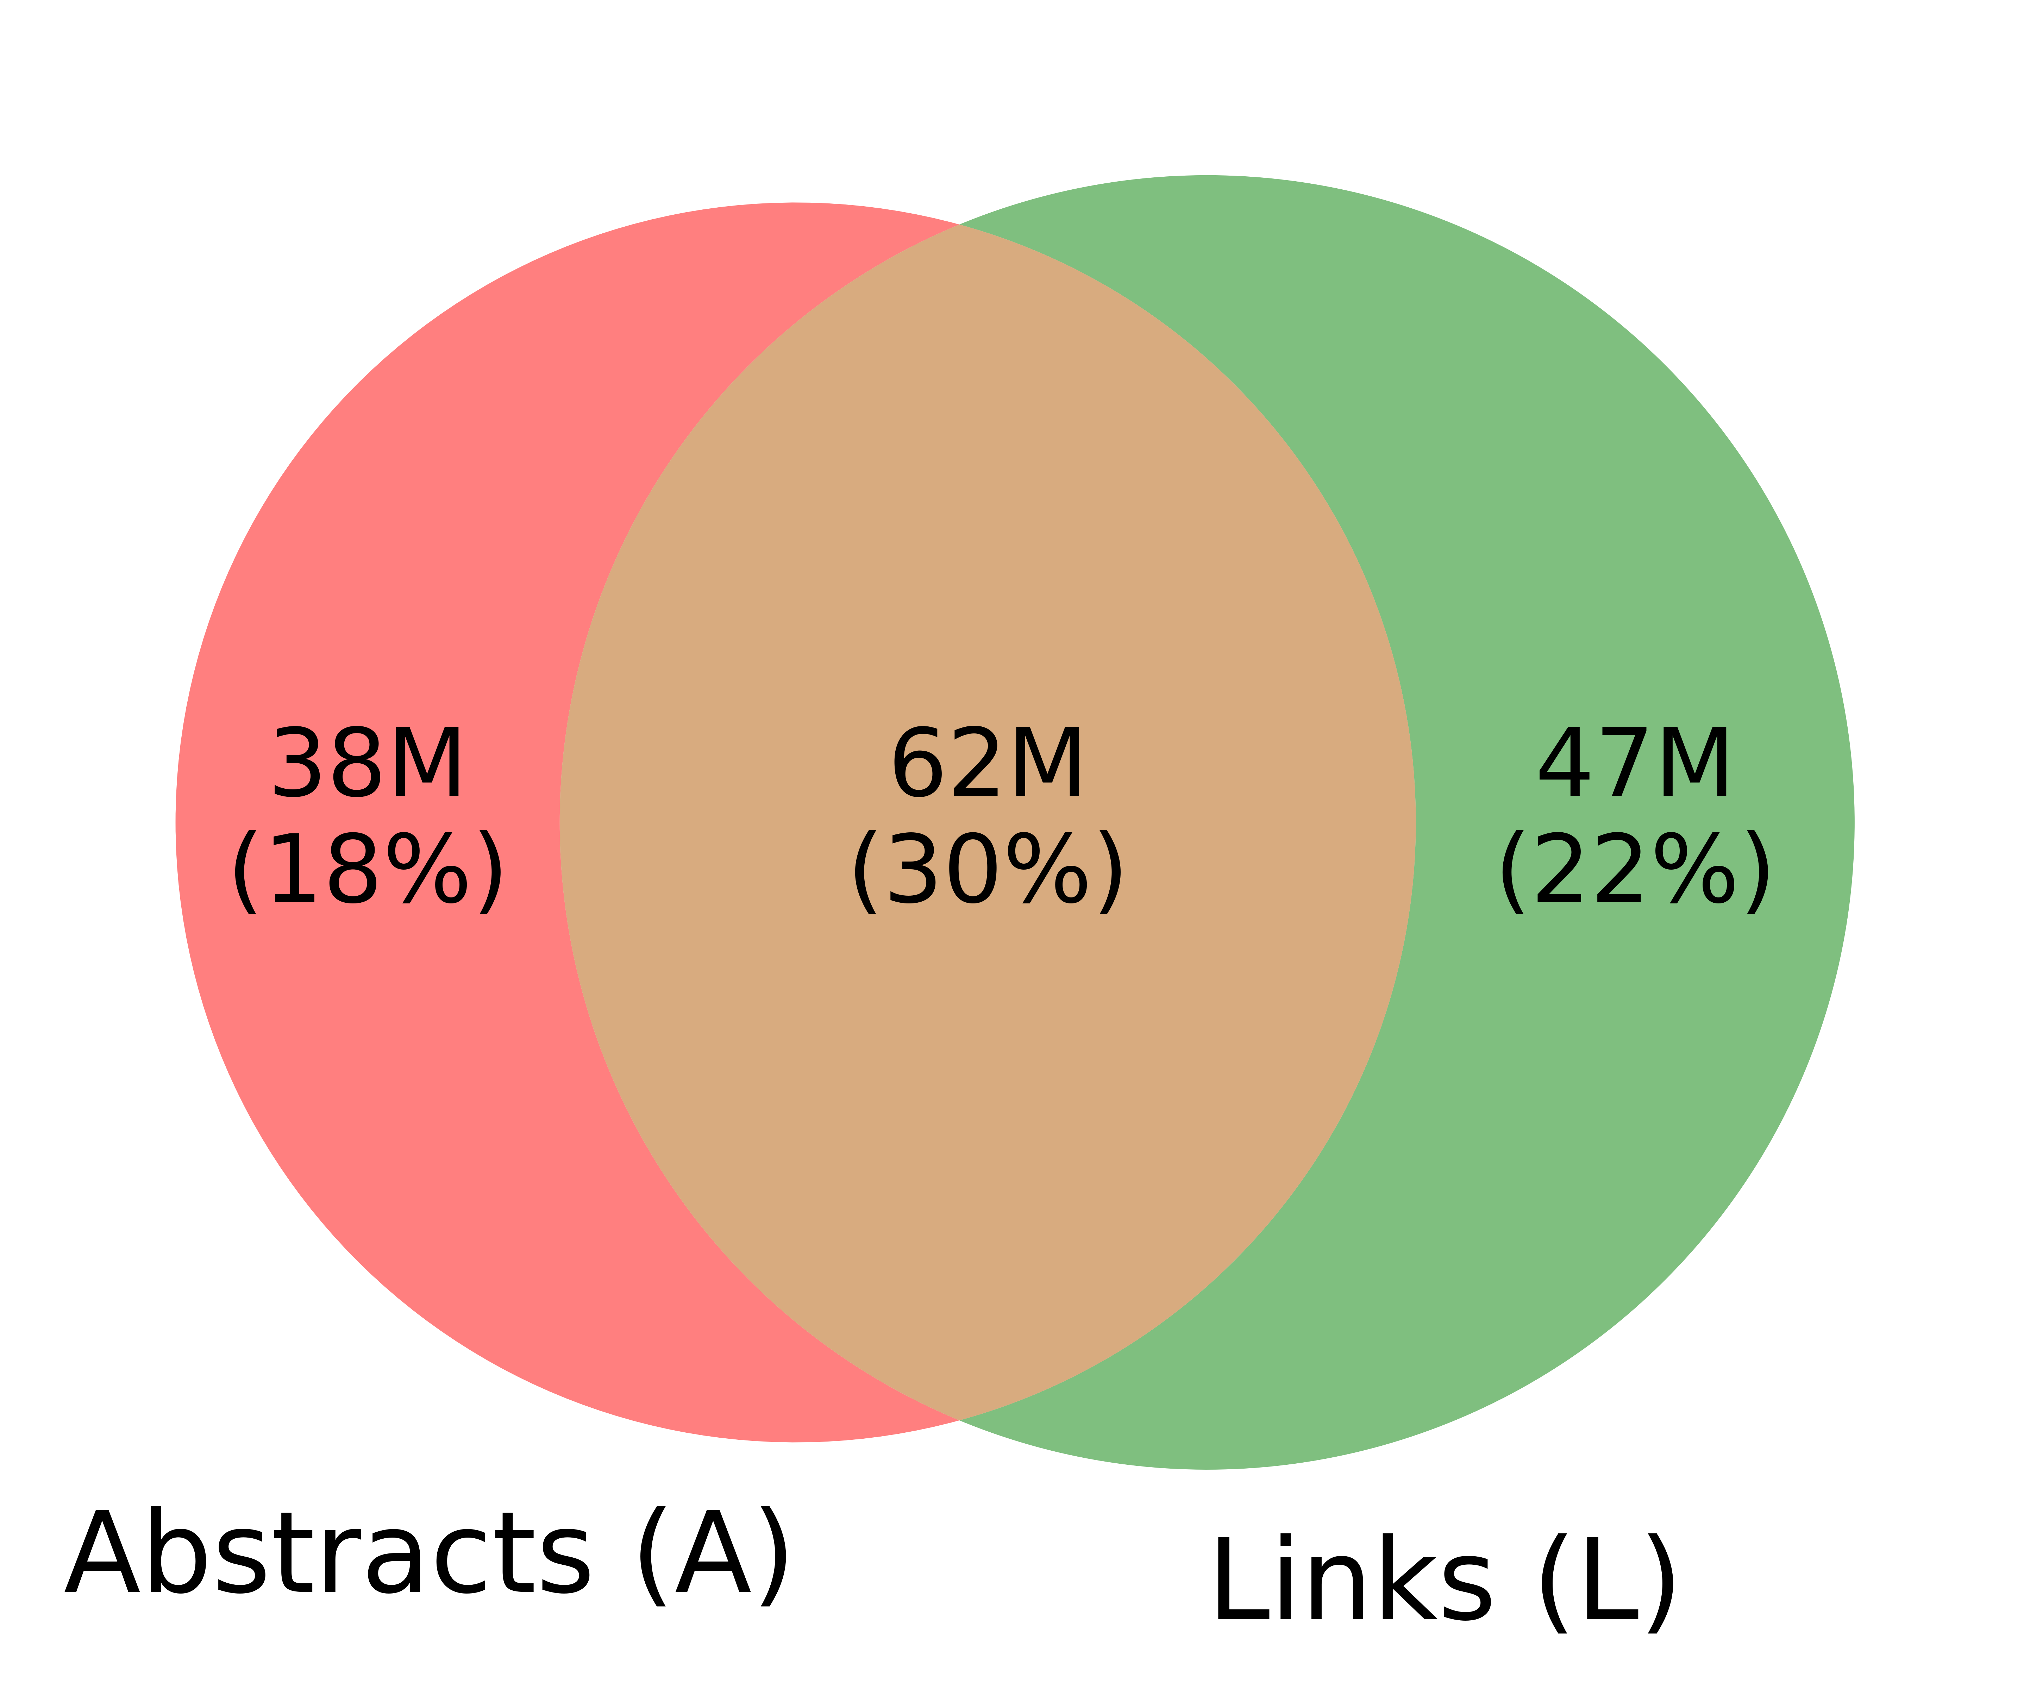
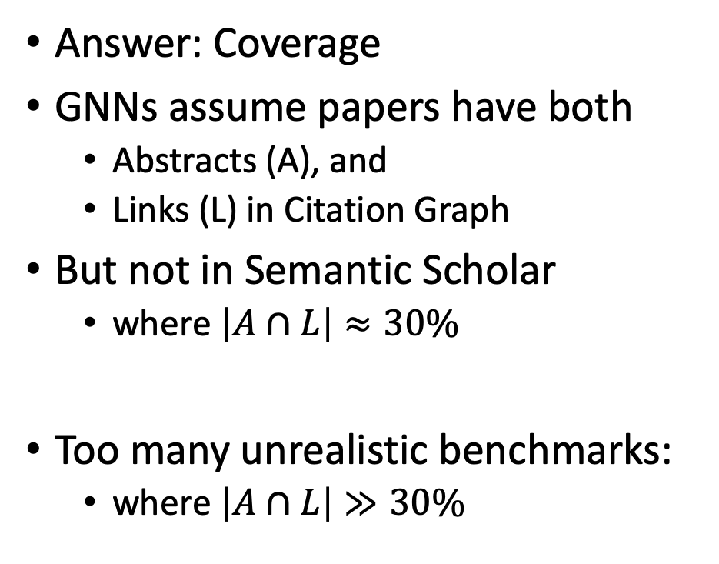
Why Better Together?
Answer: Coverage
GNNs assume papers have both
Abstracts (A), and
Links (L) in Citation Graph
But not in Semantic Scholar
where $\left|A∩L\right|≈30\%$
Too many unrealistic benchmarks:
where $\left|A∩L\right|≫30\%$

Slide 44
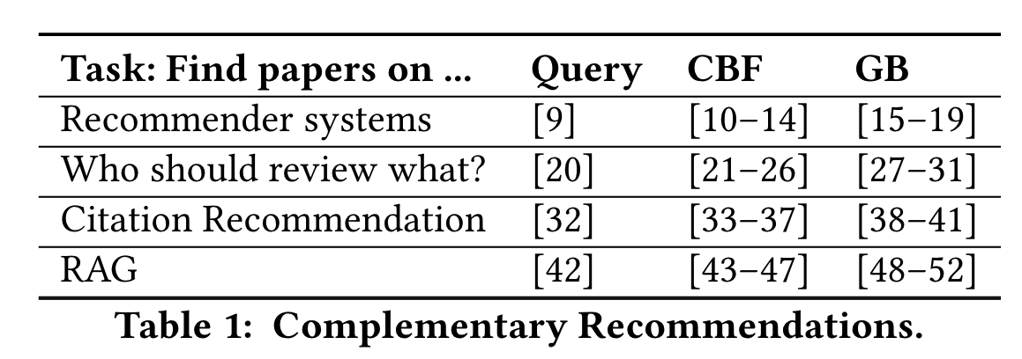
Motivating Scenario: Help Authors Write Sections on Related Work
Four subtasks
candidate list generation: list papers to discuss,
organization: organize list by topic, time, etc.,
summarization: summarize papers, and
connecting the dots: explain how papers are relevant to the present discussion

Slide 45
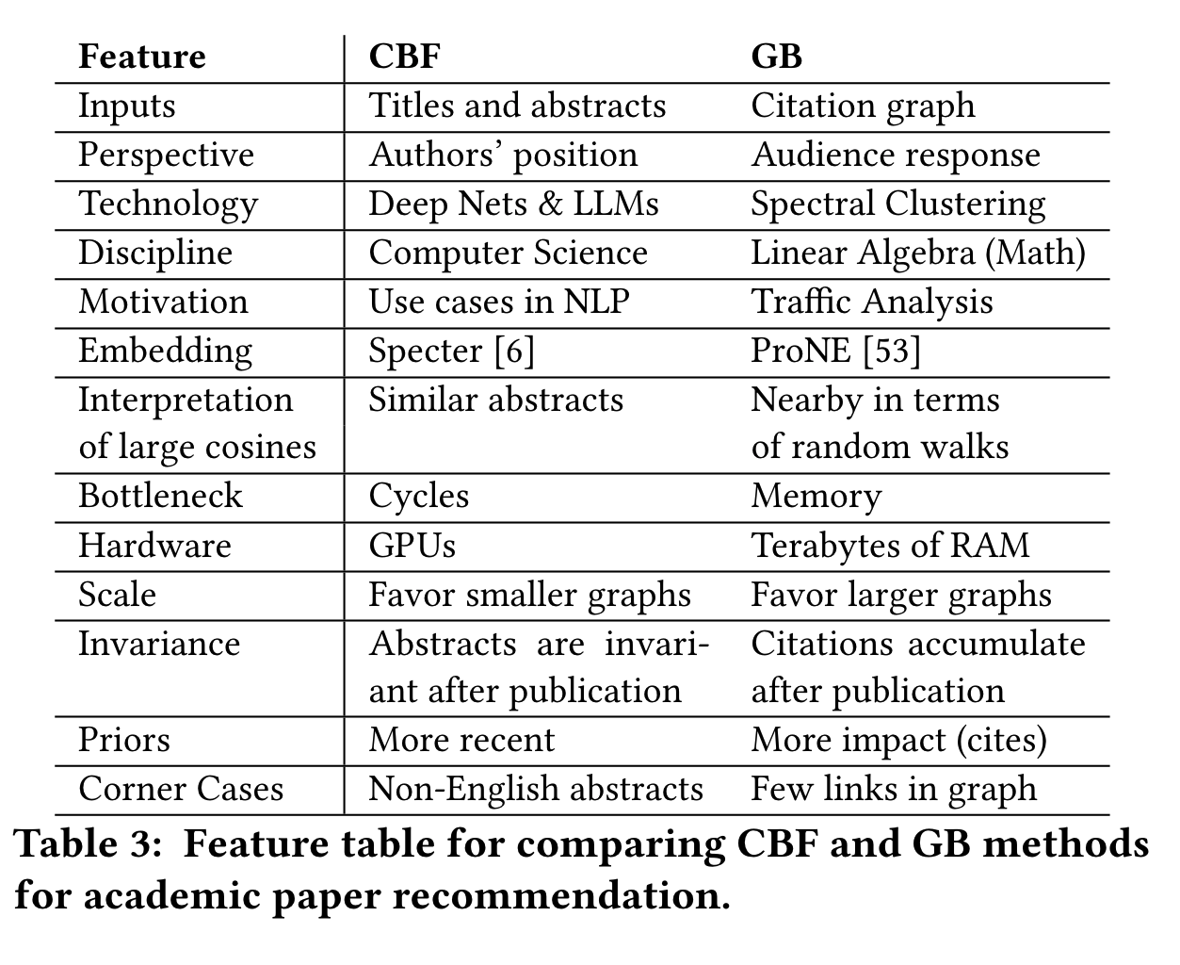
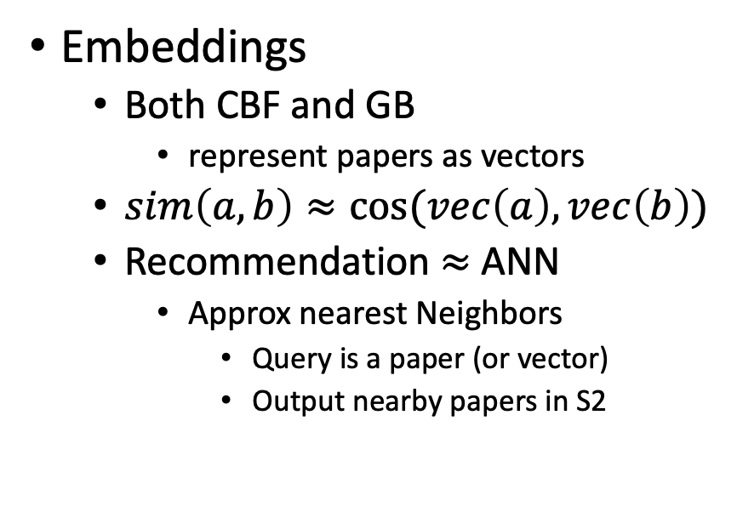
Similarities and Differences: CBF & GB
Similarities of CBF & GB
Differences between CBF & GB
Embeddings
Both CBF and GB
represent papers as vectors
$sim\left(a,b\right)≈cos⁡(vec\left(a\right),vec\left(b\right))$
Recommendation $≈$ ANN
Approx nearest Neighbors
Query is a paper (or vector)
Output nearby papers in S2

Slide 46
Differences
Inputs:
Titles and abstracts for CBF;
citations for GB.
Interpretations:
For CBF, large cosines indicate similar abstracts
for GB, large cosines indicate similarity in terms of random walks on citation graph.
History:
Deep networks evolved from NLP
whereas spectral clustering has roots in Linear Algebra
and was inspired by use cases such as traffic analysis in Applied Math.

Slide 47
Differences
Implementation Details:
We use Specter (a deep network) for CBF and ProNE (spectral clustering) for GB.
Computational Bottlenecks:
Deep networks are limited by computational cycles,
whereas spectral clustering is limited by memory.
We use GPUs for deep networks,
and terabytes of RAM to compute SVDs for spectral clustering

Slide 48
More Differences
Scale:
Larger graphs favor GB because of network effects.
Time Invariance:
CBF embeddings are time invariant because abstracts do not change after publication;
GB embeddings improve as papers accumulate citations over time.
Priors:
GB recommendations have more citations,
but are less recent
(because it takes time to accumulate citations).
Corner Cases and Missing Values:
Multiple perspectives create opportunities to improve robustness and coverage with error detection and imputing missing values.

Slide 49
Differences in More Detail

Slide 50
Inputs and Perspectives
Inputs
CBF is based on abstracts
and GB is based on citations
Many of the differences
are consequences of inputs
Perspectives
Abstracts:
authors’ perspective
Citations:
responses from audience

Slide 51
History
CBF and GB come from
different disciplines
with different motivations
Disciplines
CBF: Deep Nets & LLMs from CS
GB: Eigenvectors (like Page Rank)
Linear Algebra
Spectral Clustering
Applied Math
Motivations (Use Cases)
GB: Traffic Analysis
Know who is talking to who
But not what they are saying
CBF: NLP use cases
Situation is reversed
Know the content, but not the context of
how documents are connected to one another

Slide 52
Interpretation
Large cosines suggest papers are similar to one another
But for different reasons
CBF: large cosines →
abstracts use similar words
in terms of LLMs
GB: large cosines →
papers are near one another
in terms of random walks

Slide 53
Implementation Details
Embeddings
CBF: Specter, a BERT-like deep net
GB: ProNE, spectral clustering
For Specter,
no need for training or inference
because S2 distributes models and vectors
citations are not used for inference,
but are used for fine-tuning
For ProNE, we had to compute them ourselves (heavy lifting)

Slide 54
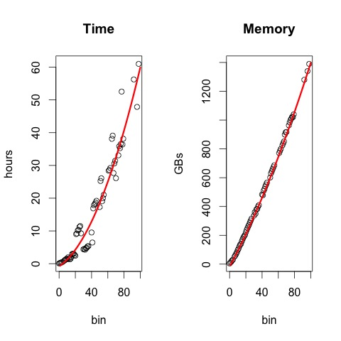

More Implementation Details
ProNE heavy lifting
It takes a few days and a few TBs
to compute SVD for larger graphs
100 bins $≈100\%$of S2
Specter fine-tuning
Start with SciBERT
fine-tune with a few million triples
$<query, pos, neg>$
ProNE trains on billions
as opposed to millions

Slide 55


Scale
Scale favors ProNE (GB)
because of network effects
Network effects (Metcalfe’s Law)
nodes: $n$
edges: $n^{2}$
paths: $2^{n}$
Citation Prediction Task
Does paper $a$ cite paper $b$?
Given pairs: $a, b$ that are 1-4 hops apart
Classification: is this pair 1 hop apart?
Binning:
Train 100 ProNE models

Slide 56



Metcalfe’s Law (Network Effects)
History: 3Com was selling small networks
3 = 1 printer + 2 computers
Metcalfe argued they should sell bigger networks
(and more 3Com products)
because of economies of scale
Economy of Scale:
Benefits scale faster than costs
Benefits: $\sim n^{2}$
Costs:$\sim n$
Law has been good for AT&T, Google, Social Media
Hypo: also good for Academic Search
Consequently, we should experiment with large graphs

Slide 57
Time Invariance and Priors
Time Invariance
Authors cannot change abstracts after publication
But audience perspective evolves over time
Citations accumulate years after publication
Priors
GB returns papers that have more citations but less recent
Because it can take time for papers to accumulate citations

Slide 58
Time Invariance and Priors
Time Invariance
Authors cannot change abstracts after publication
But audience perspective evolves over time
Citations accumulate years after publication
Priors
GB returns papers that have more citations but less recent
Because it can take time for papers to accumulate citations

Slide 59
Corner Cases
Multiple perspectives create opportunities for robustness
Detect corner cases by looking for large differences in cosines
Duplicate docs:
large CBF cosines,
but small GB cosines
Common corner cases for CBF
Duplicate documents
Missing/bogus abstracts
Non-English (Chinese)
GB does not suffer from these corner cases
But GB has other corner cases
Few (if any) links in citation graph

Slide 60

Corner Cases
$$cos\left(q,{cand}_{1}\right)$$
Multiple perspectives create opportunities for robustness
Detect corner cases by looking for large differences in cosines
Duplicate docs:
large CBF cosines,
but small GB cosines
Common corner cases for CBF
Duplicate documents
Missing/bogus abstracts
Non-English (Chinese)
GB does not suffer from these corner cases
But GB has other corner cases
Few (if any) links in citation graph

Slide 61
Corner Cases: Imputing Missing Values
Centroid Approximation
Infer a missing vector from
the average of its references
Better Together Approximation
Infer a missing vector from
the average of papers
nearby in another embedding
Synergies between CBF and GB

Slide 62
Conclusions: Better Together
Soap Box:
Interdisciplinary Re-Org: ML/Vision/NLP/MT/IR/Speech
Responsible AI: Embrace Diversity
Multiple Perspectives:
Authors vs. Audience Response
Better Together
Vision: More perspectives
subjectivity, diversity, semantics
Academic Search Deliverables:
APIs, Website, Embeddings
CBF & GB: Better Together
Complementary
Synergistic

